Slide 1
The Anatomy of Running Mechanics
Andrew Gaetano, PT, DPT, OCS, CSCS
Evan Marsh, PT, DPT Capital Area Physical Therapy & Wellness, Malta NY

Slide 2
Andrew@CapitalAreaPT.com
Parade Ground Village
7 Hemphill Place Suite 130 Malta NY 518-289-5242

Slide 3
Objectives
Understand basics of what is happening during normal running
There is no “perfect”, running is individual
Understand basic anatomy in relation to normal running
Identify normal mechanics and potential compensatory patterns
Discuss some general techniques to correct compensatory patterns
Physical Therapy examination would identify individual dysfunction and lead to individual treatment

Slide 4
Outline
Normal Running Phases
Foot/Ankle
Knee
Hip/Pelvis
Upper Extremity
Assessment of Functional Movement/Tips
Next Week
Treadmill Analysis

Slide 5
Resources
CapitalAreaHealthytips.wordpress.com
CapitalAreaPT.com
http://www.fleetfeetsports.com/resources
http://www.fleetfeetsports.com/retail/injury-prevention

Slide 6
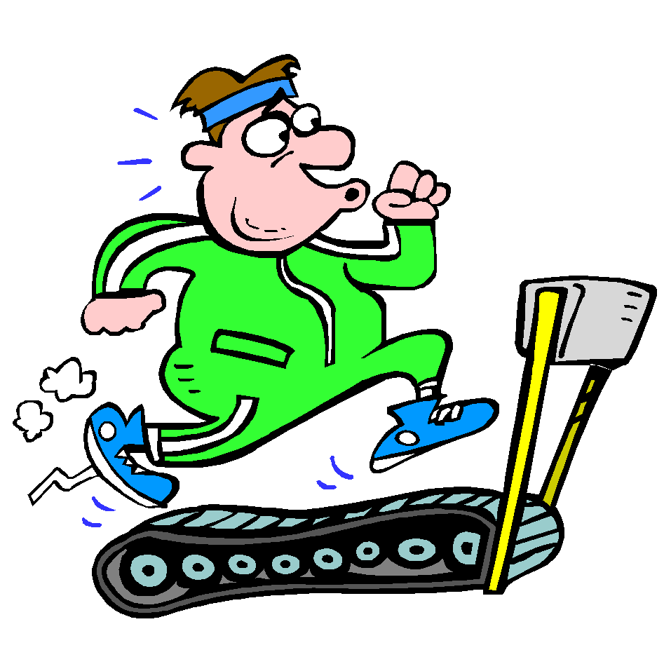
Running
Requires your entire body working together
Requires symmetry from side to side, harmony from front to back, top to bottom
Is not “physical therapy”
Running through pain is not beneficial and does not make your body tougher
Complete inactivity is also not the answer
No amount of ultrasound, electric stim, laser, icy hot, herbs, ibuprofen, activator, snake oil or other passive treatments will change your compensatory patterns. These treat the presentation of the problem, not the problem
Is different on your body from walking
Increase in cadence, length
Intensity- increase in forces
Body motion needed
3x weight of the body needs to be
absorbed with each step

Slide 7
Normal Running
Phases
Weight acceptance
Initial contact
Heel Strike? Mid-foot strike? Forefoot strike?
Loading response (from initial contact to flat foot)
Single limb support
Mid stance (flat foot to heel raise)
Terminal stance (mid stance to heel raise, pre-swing)
Swing Limb Advance
Initial swing, mid swing, terminal swing
Running has a double float phase (different from walking)

Slide 8
Running Cycle
Reference point is the right leg
TERMINAL STANCE

Slide 9
Normal Running
Essential Functional Demands in Locomotion (forward movement of body):
Forward movement- slight lean forward
Stability
Shock attenuation
Energy conservation
Single limb support
Foot clearance
Maintenance of sturdy trunk/head for vision and balance (can’t run well if you can’t see)
Goal = fluid movement

Slide 10
Normal Running
Requires ECCENTRIC activation of muscles
A type of muscle contraction that occurs as the muscle fibers lengthen, such as when a weight is lowered through a range of motion
Control of excessive motion
Deceleration
Training should take this into consideration
Assumes neuromuscular system is intact
Requires CO-CONTRACTION of certain muscles
Requires a stable trunk/core
You can’t fire a cannon from a canoe

Slide 11
Normal Running
It is just as abnormal to have too much motion as it is to have too little motion
Occurs in three planes of motion
Sagittal
Frontal
Transverse
Goal: controlled mobility

Slide 12
What is happening during the phases of normal running?
Foot/Ankle
Knee
Pelvis/Lumbar Spine
Upper Extremities

Slide 13
Foot Bony Anatomy
Outside view of right foot
(3 total)

Slide 14
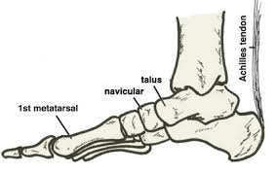
Foot/Ankle Bony Anatomy
Rear foot: Tibia/Fibula, Talus/Calcaneous
Midfoot: Talus/Navicular, Calcaneous/Cuboid
Forefoot:
Inside- Navicular, 1st and 2nd Cuneiform
Outside- Cuboid, 3rd Cuneiform, 3rd-5th Metatarsals

Slide 15
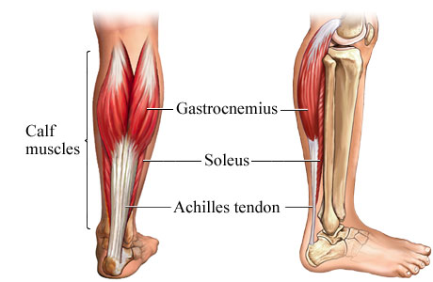
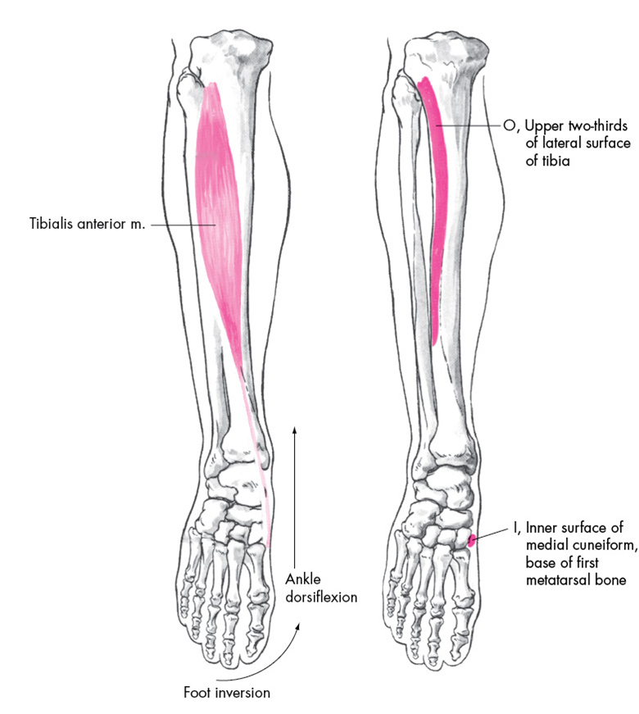
Foot/Ankle Mechanics - Initial contact
Initial Contact
Contact point changes need for motion
Need 26-30 degrees of dorsiflexion (toes up), 50 degrees of plantarflexion (toes down)
Depends on person, surface, speed, training, etc
Max dorsiflexion occurs just prior to heel raise
Heel Strike:
Eccentric control of foot lowering
Tibialis anterior
Eccentric control of knee flexion to mid stance
Soleus

Slide 16
Peroneus Longus
Begins on the outer surface of the fibula (outside of the lower leg)
Ends on the under surface of the first metatarsal

Slide 18
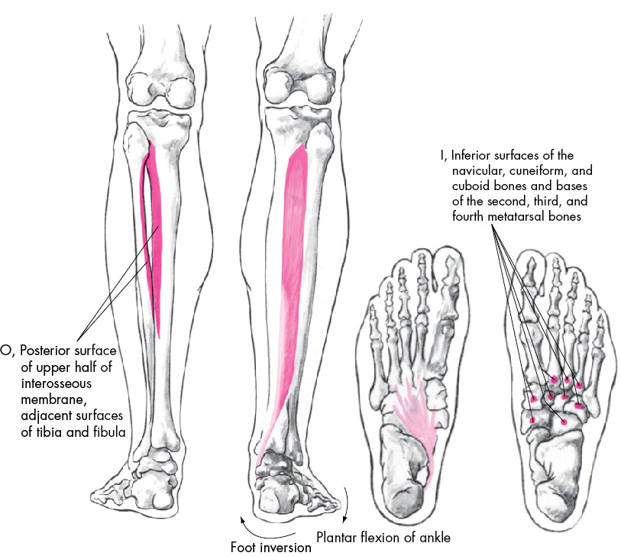
Posterior Tibialis

Slide 20
Foot/Ankle Mechanics
Weight Acceptance:
As foot accepts weight it must go from a stable/locked position (initial contact), to a more flexible (mid-stance), back to a stable/locked position (terminal stance)
Supination -> pronation -> supination
“sling shot”
The foot must have a balance between pronation and supination. Too much or too little of either motion at the wrong time of the gait cycle leads to inefficient foot function and potential dysfunction
Pronation is a normal part of the cycle and is necessary for shock absorption

Slide 21
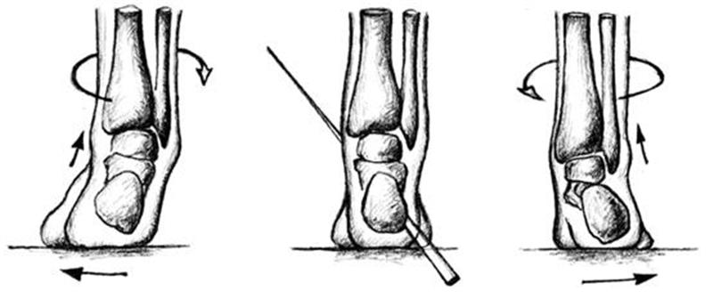
Foot/Ankle Mechanics*
Posterior Tibialis muscle works eccentrically to control arch lowering
Rear foot tilts from inside (inverted) to outside (everted) 8-12 degrees, Navicular bone drops 7-10mm
This takes .15 seconds
Proprioceptive training
End of the stance phase- foot locks back into a supinated position
8-12 degrees of outside tilting turns into 5 degrees of inside tilting
Right Foot: supinated neutral pronated
(Inversion) (Eversion)

Slide 22
Ankle- Midstance to Terminal Stance*
(Rearfoot pronation)
(Forefoot pronation)
Rearfoot pronation occurs relative to forefoot supination (forefoot does not pronate as fast as rearfoot)
Deceleration occurs: creates lowering of the arch (controlled), lengthening and tension in plantar fascia- creating elastic potential energy
Near terminal stance we want more of a stable foot: rear foot goes back to supination- Peroneus longus activates (don’t want to roll weight on the outside of the foot)- this creates a stabilizing sling for the foot

Slide 23
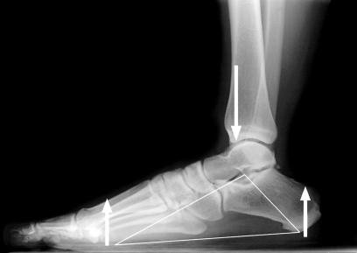
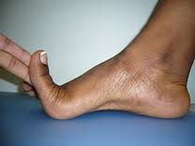
Controlling Over-Pronation
Structures that control pronation: Posterior tibialis, peroneus logus, soleus, ligaments (spring ligament),plantar fascia, joint stiffness.
“Windlass effect”- winding of the plantar fascia creates shortening of the space between the forefoot and rear foot-raising the arch
This demonstrates importance of 1st toe extension of at least 65-70 degrees

Slide 24
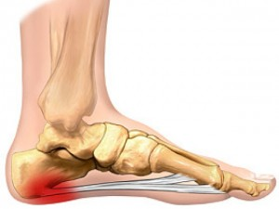
Foot dysfunction leading to conditions
Plantar Fasciitis
Minimizing rate/range of excessive pronation
Loss of dorsiflexion range of motion
Stress Factures
Avoiding high initial forces and forces during stance phase
Ensuring proper timing and control of major stabilizing muscles
Achilles Tendinosis
Proper tissue adaptation time
Proper eccentric control/strength
Right, normal
Front, SM
Right, SM

Slide 25
Knee Bony Anatomy
Knee mainly flexes and extends but does move a slight into rotation and side/side (varus/valgus). If excessive or lacking, compensation develops

Slide 27
Knee Mechanics- Initial Contact
Initial Contact: knee is slightly flexed (20 degrees)
“reverse heel strike”: hamstring co-contraction with quadriceps in terminal swing phase
Weight acceptance: 20 degrees of knee flexion turns into about 35-40 degrees
Quadriceps absorb this eccentrically

Slide 28
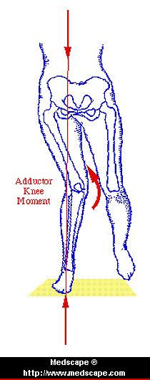
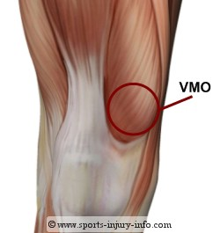
Knee Mechanics-Midstance to Terminal Stance
Quadriceps Muscle: Your #1 Shock Absorber
Eccentric control at initial contact- midstance
Injury, joint effusion, atrophy?
Foot hits ground: knee flexes, patella goes through natural slight outer tracking controlled by vastus medialis oblique (part of quadriceps)
Must control excessive internal rotation and adduction of femur

Slide 29
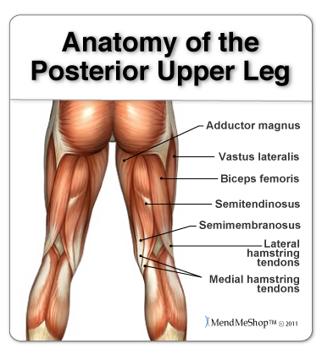
Knee Mechanics- Swing Phase
Swing knee flexes- relates to dorsiflexion range of motion
Hamstrings set up proper stance phase mechanics
eccentrically controls knee extension (peaks at reverse heel strike- then works concentrically) at same time: commences hip extension at the point of strike
Needs to be balance between inside and outside hamstring pull to avoid rotation of tibia
Excessive pull on either side can create abnormal rotation

Slide 30
Knee Dysfunction Leading to Conditions
Patellofemoral Pain
Loss of “reverse heel strike”, hamstring co-contraction
Quadriceps dysfunction, Vastus medialis oblique
Hip and/or ankle dysfunction creating excessive line or pull
Patellar Tendonosis
Loss of eccentric control of quads
Hip and/or knee dysfunction
ITB syndrome
Right, SM
Left, SM

Slide 31
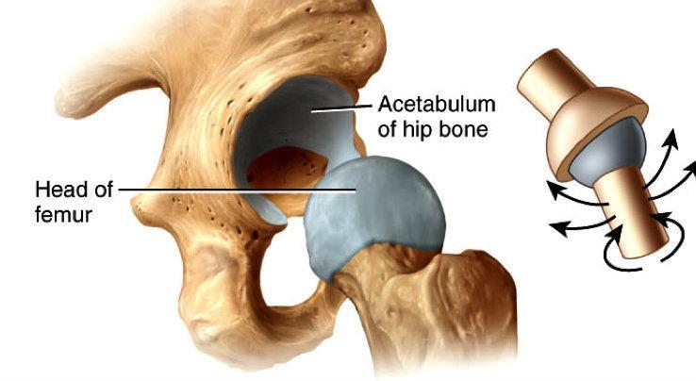
Hip Bony Anatomy

Slide 32
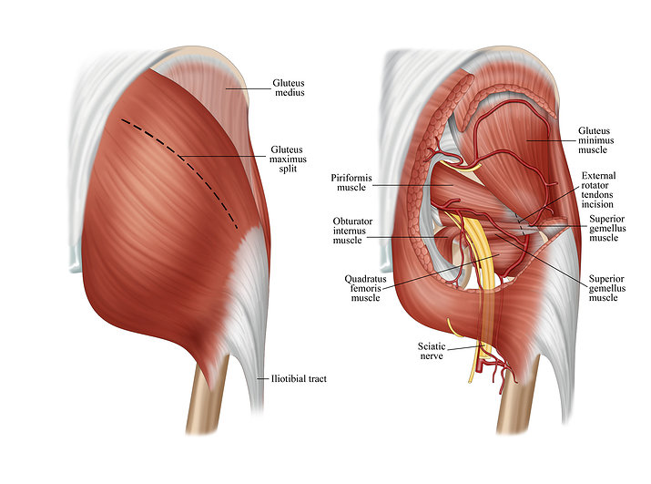

Slide 34
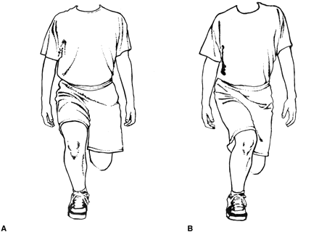
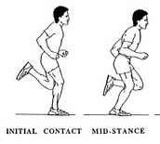
Hip at Initial Contact
At initial contact hip shows 20 degrees flexion
“strike underneath hips”- ankle slightly behind knee and only mildly in front of hips
Eccentric control of hip: gluteus maximus and gluteus medius
Limits excessive hip inward rotation and adduction

Slide 35
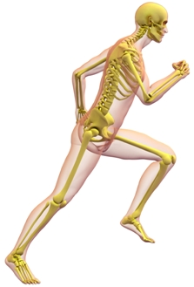
Hip during mid-terminal stance
Continued control of gluteus medius/maximus
Strike pattern should look like running down a line. Foot prints may overlap each other but not cross. Should not be too far spread apart
Terminal stance: 20 degrees hip extension
May look like more may also come from pelvic and lower back extension- potential source of compensation if restrictions in hip joint

Slide 36
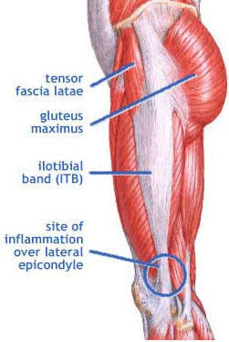
Stance phase hip dysfunction

Slide 37
Hip Dysfunction leading to conditions
ITB syndrome
Greater Trochanteric Bursitis
Piriformis Syndrome
Sacroiliac joint pain
Hamstring injuries
Without proper gluteus maximus activation hamstings constantly pulling on itself
Back, SM

Slide 38
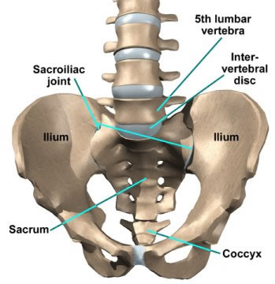
Pelvis/Spine
A stable base which can support and allow for the rest of the movement to occur
Has to also allow for controlled mobility in all 3 planes
Pelvic biomechanical abnormalities that lead most to injury:
excessive forward (anterior) pelvic tilt
excessive lateral tilting
asymmetric movement from side-side

Slide 39
Front view of abdominal muscles

Slide 40
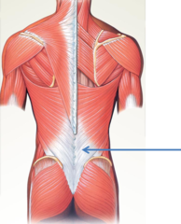
Dynamic “Core” Stability

Slide 41
Pelvis/Spine- Initial Contact
Pelvis slightly rotated backward on the same side at initial contact
Need: Pre-contraction of transversus abdominis and laying of core muscles with higher demand motion (i.e impact/loading phase)
Pelvis begins to rotate forward (anterior) with weight acceptance, peaking at toe off
Excessive forward pelvic tilt may result from tight hips, tight hip flexor muscles

Slide 42
Psoas Major: attaching to the spine, then the front of the hip

Slide 43
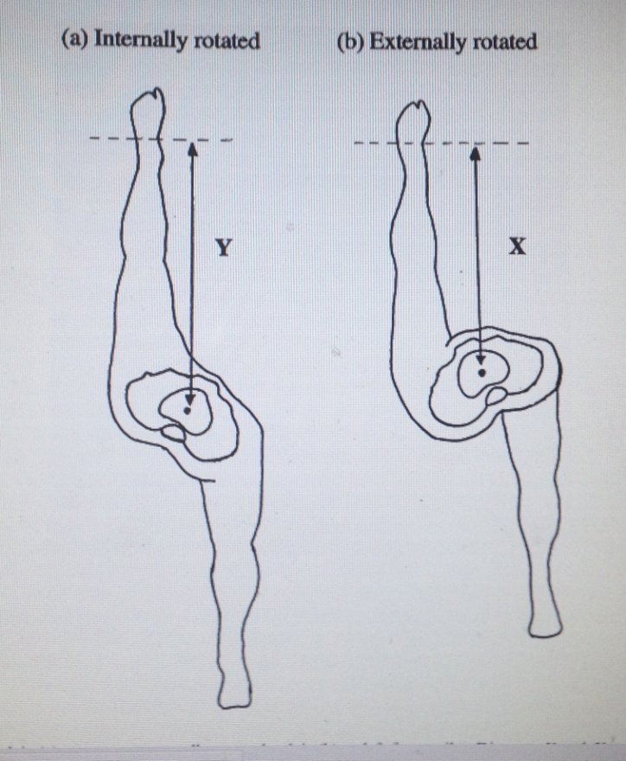
Pelvis/Spine- Mid stance
10-15 degrees of pelvic rotation
Increases with speed
Counter-acted by trunk rotation
Abdominals work in oblique plane
Tension opposite internal/external oblique- becomes like a “sling”- “winds up”- saves energy
Spine side-bending
Segment to segment

Slide 44
Pelvis/Spine
There are 29 “core” muscles that absorb and distribute impact forces, and allow body movements in a controlled efficient manner
Abdominals
Paraspinals
Gluteal muscles
Pelvic floor muscles
Hip girdle
Diaphragm
Endurance

Slide 45
Upper Extremities
Provide balance and promote efficiency/stability
Helps balance all planes of motion- if you don’t have this, creates excessive motion else where
Each arm movement counter balances the opposite leg during swing phase
Should match lower extremity motion
Generates forward momentum
All of this sequences with arms: as we flex one hip, flex opposite arm at same time
Minimizes twisting of torso and pelvis- saves energy and allows for maximum stride

Slide 46
Excessive crossover: possible indicator lack of stability

Slide 47
Upper Extremities
If arm swing is not sufficient, hip flexion/adduction, knee flexion/adduction and ankle abduction have increase joint angles
Symmetry of motion important: if not sequenced appropriately, leads to compensation, dysfunction and creates breakdown/shear
Back, SM
Front, SM

Slide 48
Functional Movement Assessment
Identify potential areas of compensation, restriction, or loss of control
Patterns that require several areas working together
Movements that are required for day to day use, sport specific
Next week

Slide 49
Principles of good training
Consistency, rest days
Stretch dynamically, incorporate stability, sharpening/technical drills
Mileage- steady progressions (30% of total runs are the long runs)
Vary running surface
Intensity: 30% of total runs are the intense runs recovery techniques; training + rest= success (back off on a regular basis)
Monitoring techniques: listen to body for clues- change in heart rate, sleep patterns, stress levels, morning stiffness

Slide 50
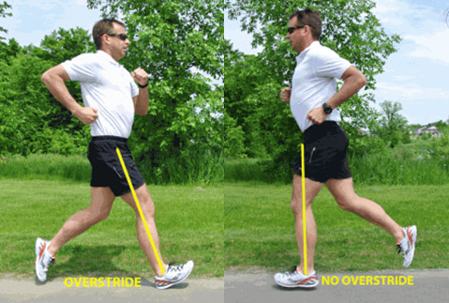
Questions
Barefoot Running
Forefoot striking increases ankle stiffness, decreases stresses on knee
You cannot switch immediately to barefoot running
Risk of injury when not enough transition time provided for tissue adaption
Cadence: Normal is around 88-90 strides per minute
Stride:

Slide 51
Questions
Injury prevention
Training errors- what has changed?
Mileage (sudden change, clustering)
Intensity
Surface: side of road, cushion, variety, shoes
Consistency (erratic or unrelenting)
Ensuring adequate range, flexibility, and stability
Treadmill Analysis: part of our physical therapy, covered by insurance in those appropriate for PT
http://www.fleetfeetsports.com/training-programs

Slide 52
References
Cavanagh P (Ed.) (1990), Biomechanics of Distance Running. Human Kinetics
Nicola, Terry. The Anatomy and Biomechanics of Running. Clin Sports Med 31 (2012) 187-201
Schache, Anthony. The coordinated movement of the lumbo-pelvic-hip complex during running: a literature review. Gate and Posture 10 (1999). 30-46
Walsh, Matthew. The Running Athlete: Parts A, B, and C. http://www.medbridgeeducation.com
Http://www.themanualtherapist.com

